Slide 1
Predicting Air Quality in Milan
Dan Herweg
May 2019

Slide 2
The Air Quality in Milan is over 80% predictable using ensemble models and 5 variables, 4 of which are weather Summary
Milan struggles with air quality, an important health issue. Decision makers could benefit from being able to predict the Air Quality Index on an hourly basis
Using sensor data for weather and traffic to predict the index, it has been found that the AQI is over 80% predictable, mostly using weather variables. They are:
Atmospheric Pressure
Wind Speed
Temperature
Relative Humidity
Traffic
The random forest and bagging model were most accurate, but the bagging model presented fewer large errors and should be preferred
Data collection should continue, and the model should be retrained regularly to overcome initial weaknesses in analysis

Slide 3
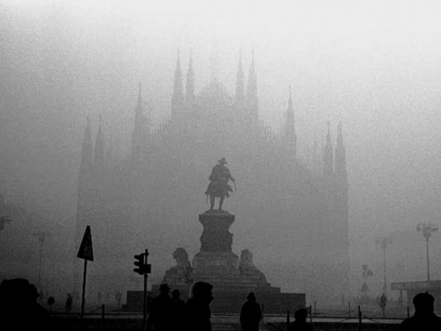

Slide 4
Contents
Background
Motivation
Methodology
Data
Feature Construction
Data Exploration
Model
Train/Test Split
Predicting AQI
Feature Selection
Final Model
Conclusion
Recommendation

Slide 5
I. Background
Motivation
Methodology

Slide 6

Milan has poor air quality Motivation
Background
A report by the World Health Organization has placed Milan just behind Turin and just before Naples as the three European cities with the worst levels of atmospheric pollution.
Article based on WHO report using 2016 data
https://www.wantedinmilan.com/news/milan-has-second-worst-smog-in-europe-who.html

Slide 7
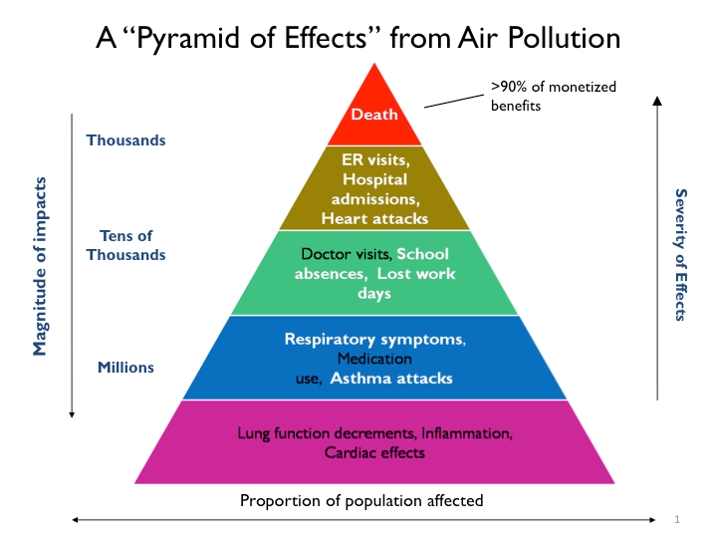
Poor air quality affects citizens’ health Motivation
Background
Fine particles can enter deep into the lungs and enter the blood stream. Health impacts from particles include:
Premature death
Non-fatal heart attacks
Aggravated asthma
US Environmental Protection Agency
https://www.epa.gov/benmap/how-benmap-ce-estimates-health-and-economic-effects-air-pollution

Slide 8
Background
Predicting AQI could help decision makers introduce interventions that are predicted to manage air quality in real time improving citizens’ health

Slide 9
I. Background
Motivation
Methodology

Slide 10
We will take sensor data from weather and traffic to predict AQI using machine learning methods, selecting on accuracy Methodology
Background
First, data from weather stations, pollution sensors, and traffic gates will be cleaned and explored. The Air Quality Index target variable will be constructed
Next, the numerical and categorical AQI will be computed directly and by first predicting pollutants
The best features will be selected and the best model will be chosen based on accuracy in predicting the categorical AQI

Slide 11
II. Data
Feature Construction
Data Exploration

Slide 12
Data had to be extracted from files generated by sensors, cleaned and merged Feature Construction
Data
Milan Sensor Locations
The data had three main sources
Weather Sensors
Traffic Gates
Pollution Sensors (used to calculate AQI)
Sensors measuring the same data were averaged

Slide 13
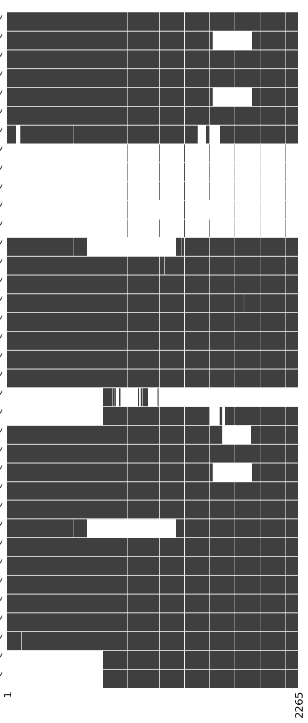
Missing data was an issue Feature Construction
Data
Sensor Data Quality
White Areas = Missing Data
Values for missing data were imputed using random forest on the type of data that had missing values
Some sensors only had daily data
Pollution
Sensors
Some sensors had random periods of missing data
Time

Slide 14
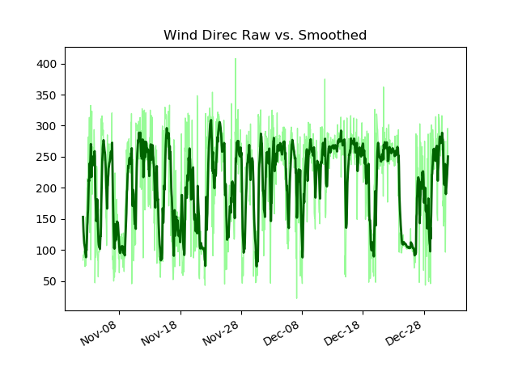
Noisy data was an issue Feature Construction
Data
Noisy time series data with potential for measurement errors was smoothed

Slide 15
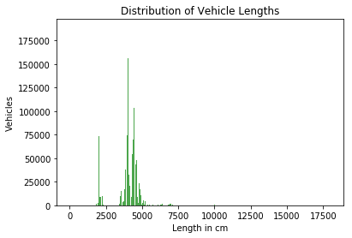
Some features were constructed by grouping raw data Feature Construction
Data
The vehicle length categories were selected by visually inspecting the distribution to identify a “small” mode, a “medium” mode, and a “large” tail
Small
Med
Large
A time of day variable was constructed by grouping hours as the following:
Morning: 5-11am
Mid day = 11am-3pm
Evening = 3-8pm
Night = 8pm-5am

Slide 16
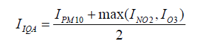
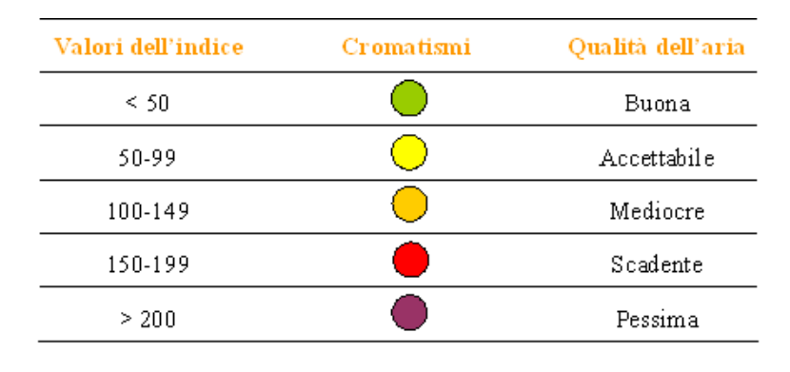
AQI had to be calculated and then transformed to a classifier to serve as the target variables Feature Construction
Data
The AQI numerical calculation:
Categorical classification of AQI values:

Slide 17
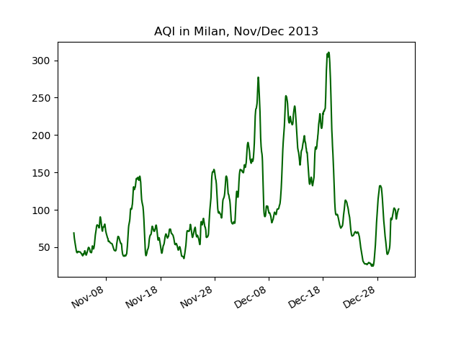
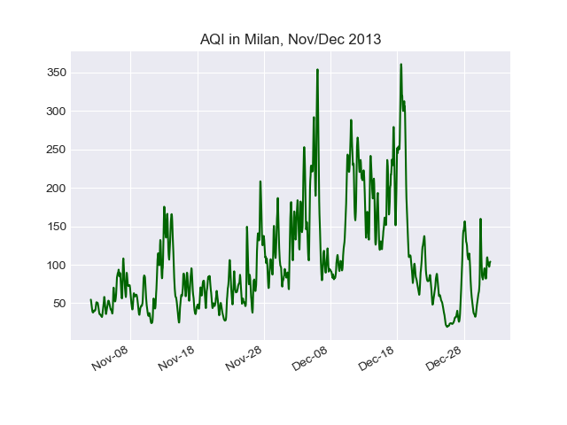
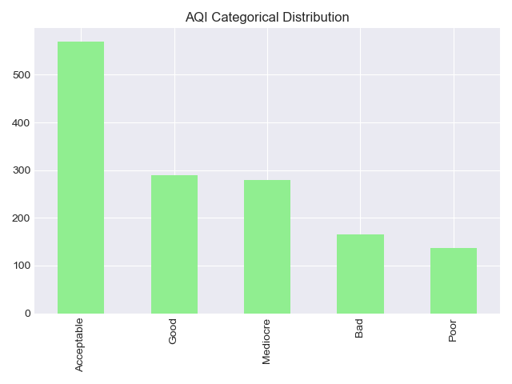
Air Quality Index score and class distribution Feature Construction
Data

Slide 18
II. Data
Feature Construction
Data Exploration
Univariate
Multivariate

Slide 19
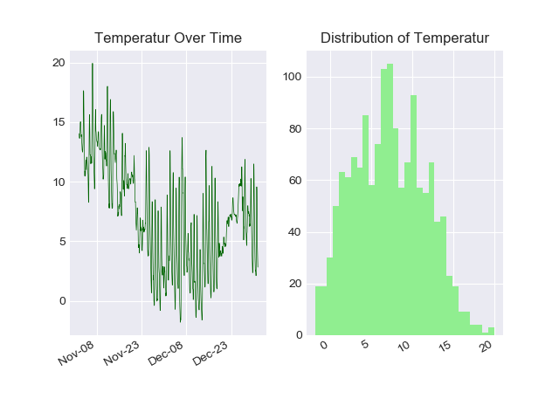
Temperature had a normal distribution and declined into year end Data Exploration - Univariate
Data
Degrees Celsius
Frequency
Degrees Celsius

Slide 20
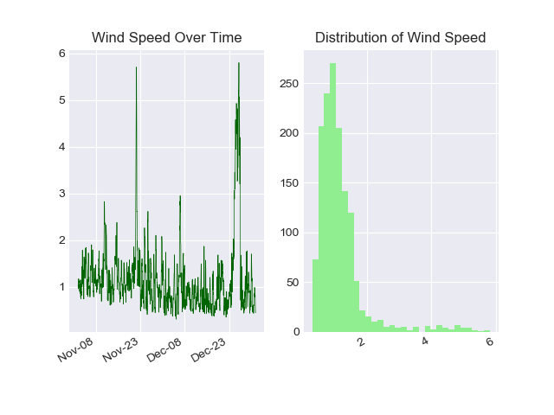
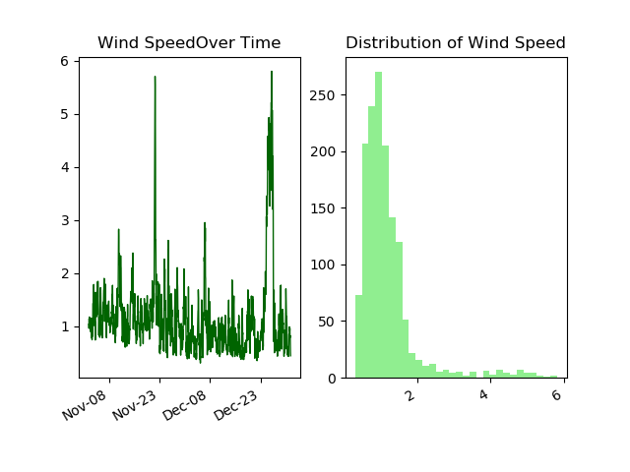
Wind speed was very right skewed, with high peaks Data Exploration - Univariate
Data
m/s
Frequency
m/s

Slide 21
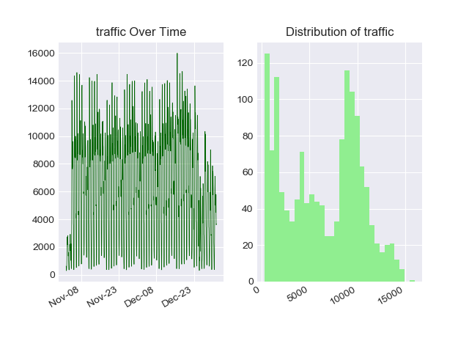
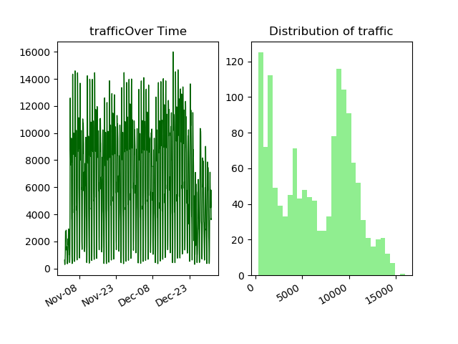
Traffic had daily and weekly patterns and a distribution with multiple peaks Data Exploration - Univariate
Data
Vehicles/Hour
Frequency
Vehicles/Hour

Slide 22
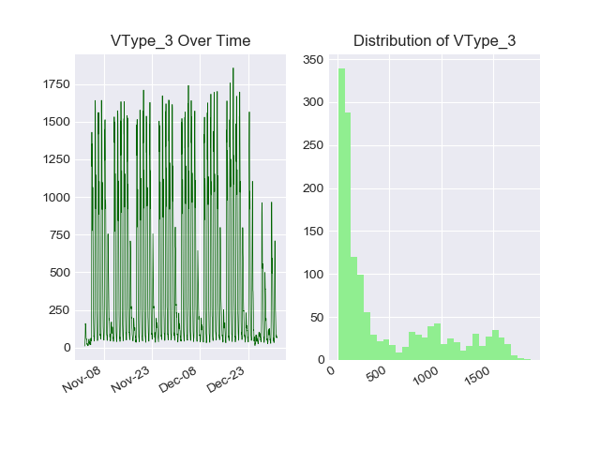
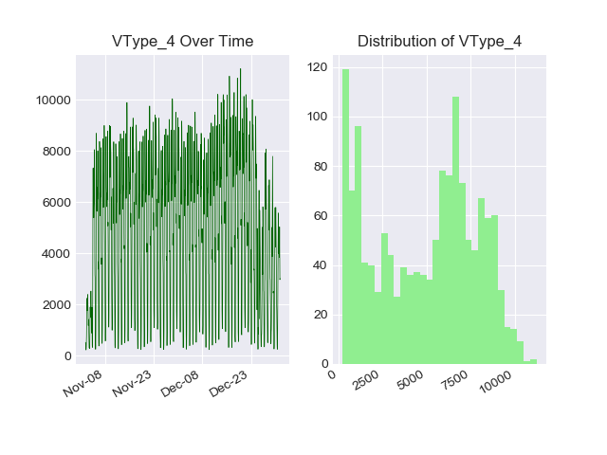
Within traffic, different vehicle types had distinct behaviors Data Exploration - Univariate
Data
Freight Vehicles
Right skewed distribution vs. multi-modal distribution
Pronounced weekend troughs vs. less visible weekends
Vehicles/Hour
Frequency
People Vehicles
Pronounced weekend troughsvs. less visible weekends
Pronounced weekend troughs vs. less visible weekends
Vehicles/Hour
Frequency

Slide 23
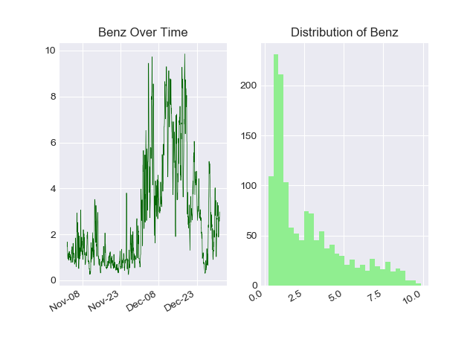
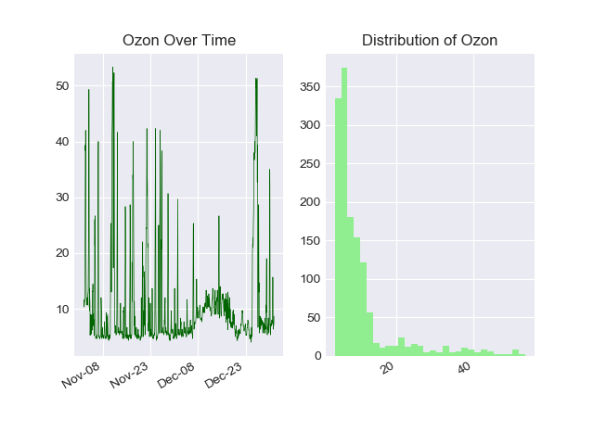
Benzine, a pollutant not in the AQI calculation, looked similar to the AQI over time Data Exploration - Univariate
Data
µg/m
Frequency

Slide 24
However Ozone, a component of the AQI, showed a different pattern Data Exploration - Univariate
Data
µg/m3
Frequency

Slide 25
II. Data
Feature Construction
Data Exploration
Univariate
Multivariate

Slide 26
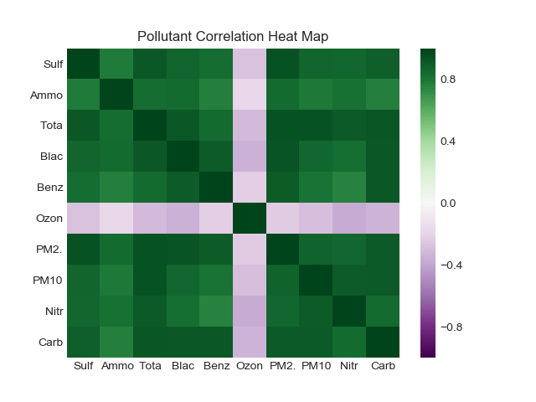

Pollutants are very correlated except ozone Data Exploration - Multivariate
Data

Slide 27
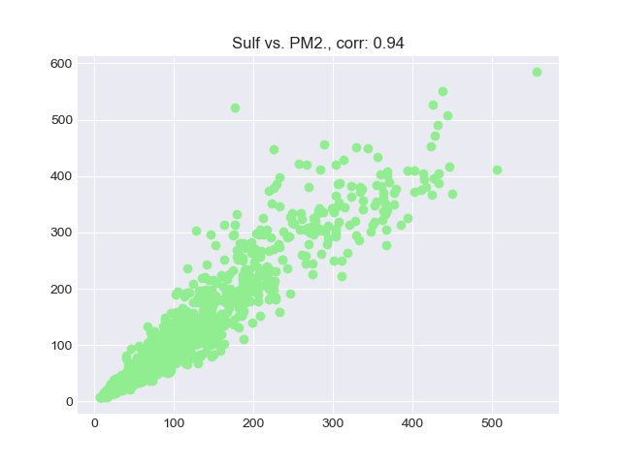
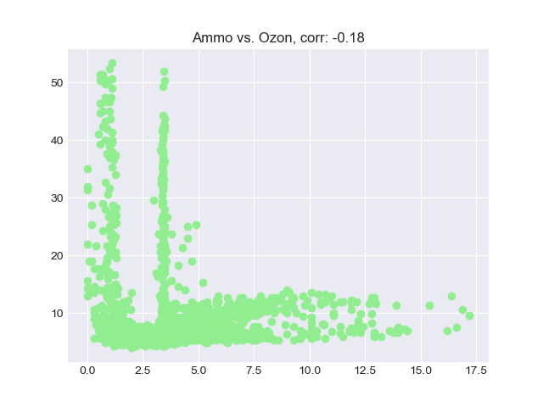
Pollutants are very correlated except ozone Data Exploration - Multivariate
Data
PM 2.5, µg/m
Ozone, µg/m3
Sulfur Dioxide, µg/m
Ammonia, µg/m

Slide 28
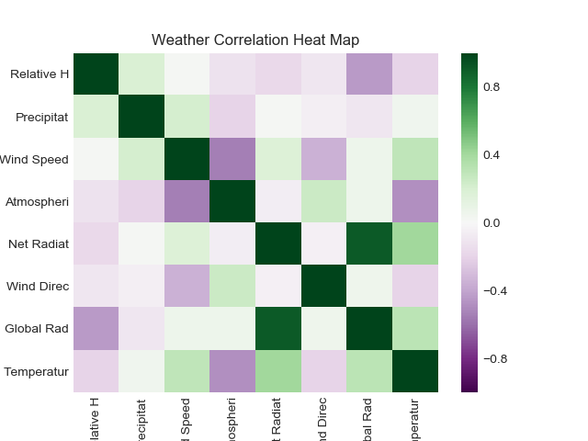
Weather data is not very correlated except the two radiation measures Data Exploration - Multivariate
Data

Slide 29
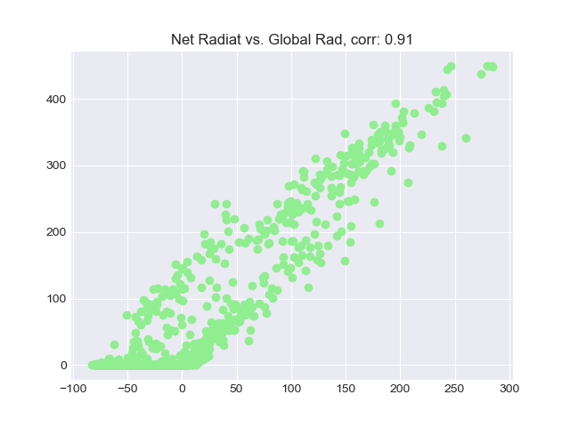
Weather data is not very correlated except the two radiation measures Data Exploration - Multivariate
Data

Slide 30
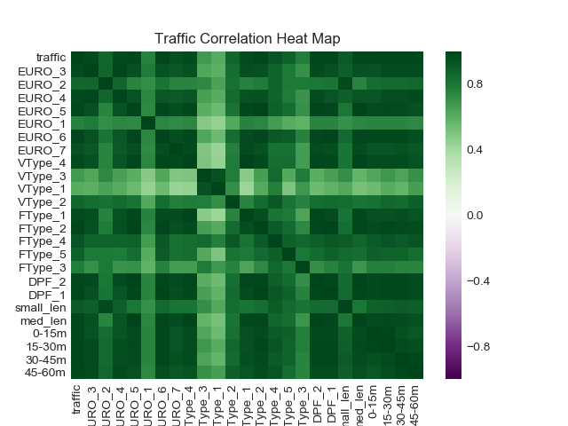
Traffic data is more correlated, and all positively correlated Data Exploration - Multivariate
Data
The only variables that seem uncorrelated are “Other” and Freight Vehicles, which are correlated with each other

Slide 31
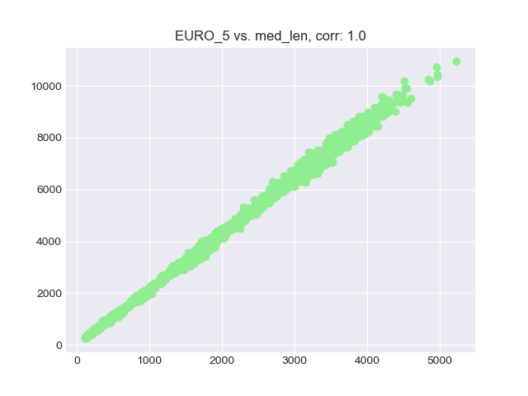
Traffic data is more correlated, and all positively correlated Data Exploration - Multivariate
Data
The correlation of the number of Euro 5 emissions designated vehicles and the number of medium length vehicles rounds to 1!
Vehicles
Vehicles

Slide 32
III. Model
Train/Test Split
Predicting AQI
Feature Selection
Best Model

Slide 33
Data limitations forced tradeoffs in choosing train and test sets Train/Test Split
Model
We do not have a lot of data
The data ends in the end of December, an unrepresentative period
Intuitively, traffic patterns are expected to be anomalous
Technically, the target variable distribution is unbalanced
There is a secular decrease in temperatures and not a full year of data to compare the whole cycle
Since a sequential train/test split may not be feasible at this time, a stratified sampling technique was used to split the data
As more data is collected, this should be revisited to reduce dependence between the training and testing set, especially when using smoothed data

Slide 34
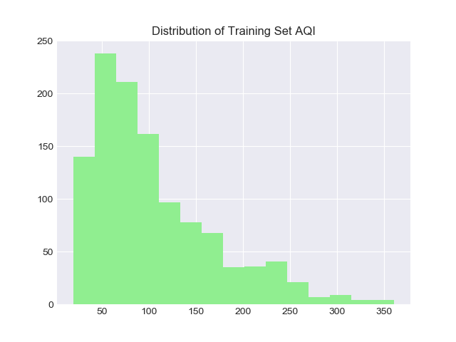
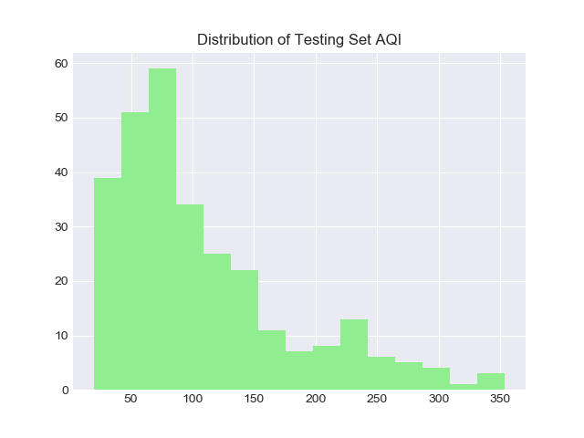
The distributions of the classes in the train and test sets Train/Test Split
Model
Frequency
Frequency
AQI
AQI

Slide 35
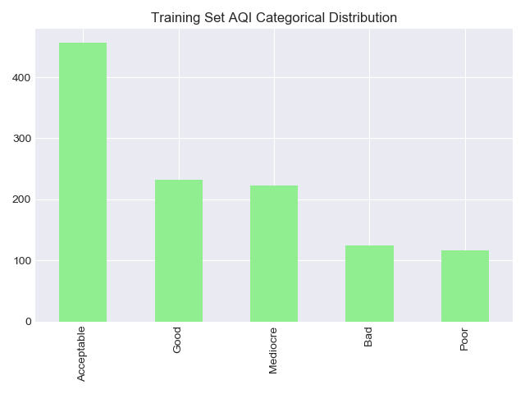
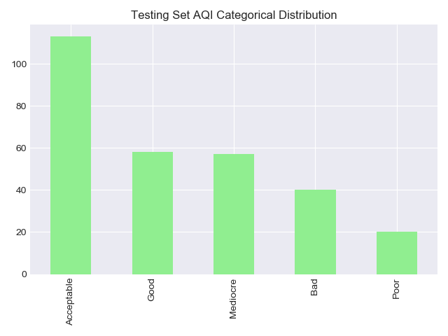
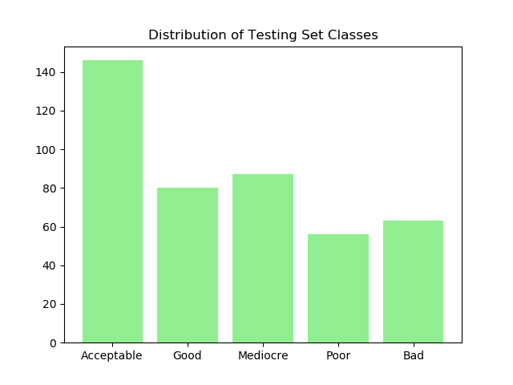
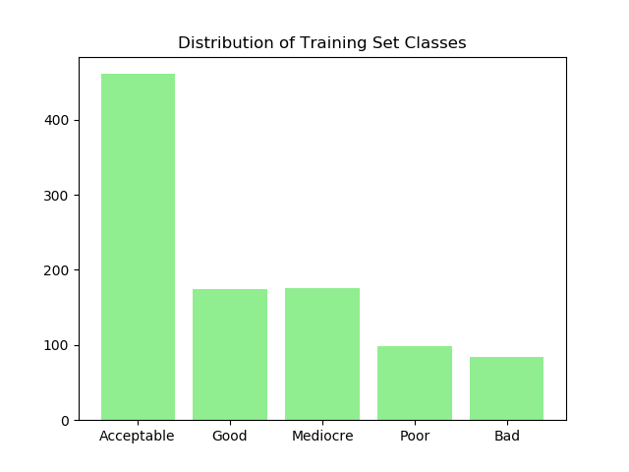
The distributions of the classes in the train and test sets Train/Test Split
Model

Slide 36
III. Model
Train/Test Split
Predicting AQI
Feature Selection
Final Model

Slide 37
A naïve result serves as a benchmark Predicting AQI
Model
Guessing the average AQI gave a mean squared error of 5,070
Guessing the modal AQI class “Acceptable” yielded an accuracy of 39%

Slide 38
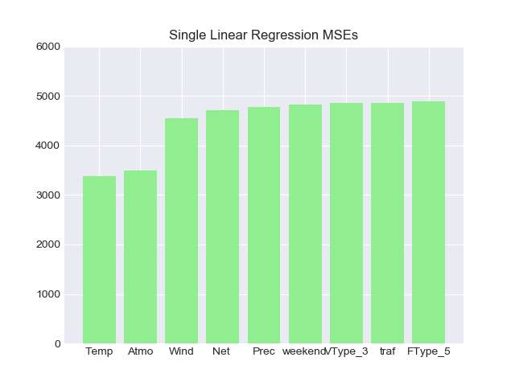
Regressing each variable on AQI yielded better MSE than the naïve model by construction Predicting AQI
Model
5,070
Naïve Model
3,382
Temperature SLR
MSE

Slide 39
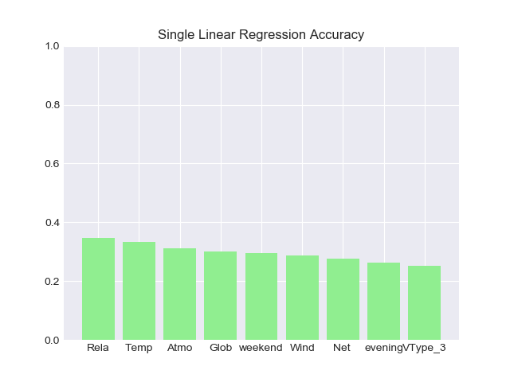
Single linear regressions did not improve accuracy over the naïve model Predicting AQI
Model
Accuracy
39%
Naïve Model
39%

Slide 40
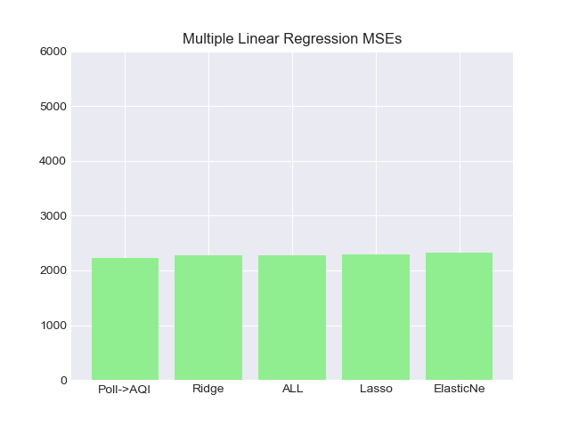
Multiple regression methods further reduced MSE vs. SLR. The best model predicted individual pollutants to compute AQI Predicting AQI
Model
3,382
Temperature SLR
MSE
2,232
MLR to predict individual pollutants

Slide 41
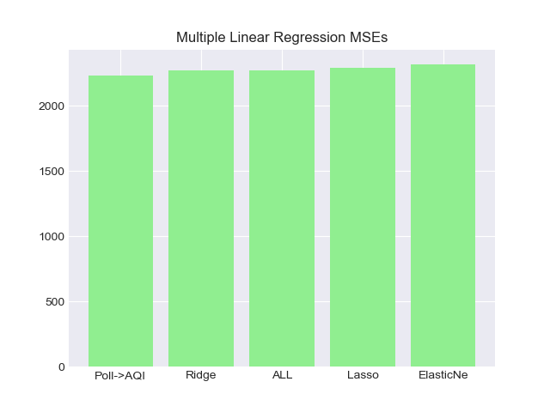
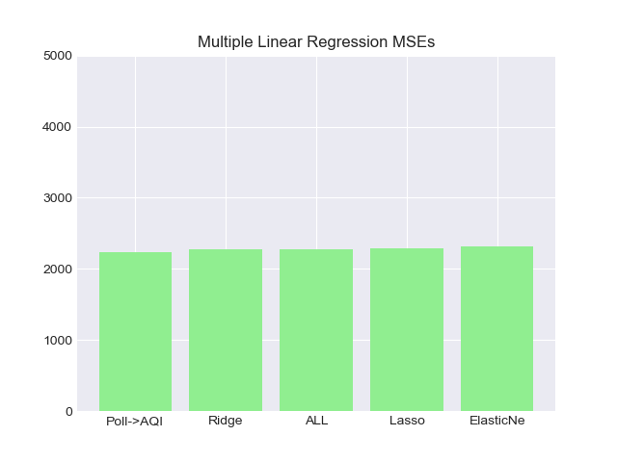
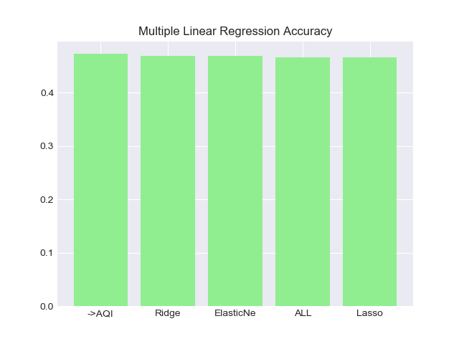
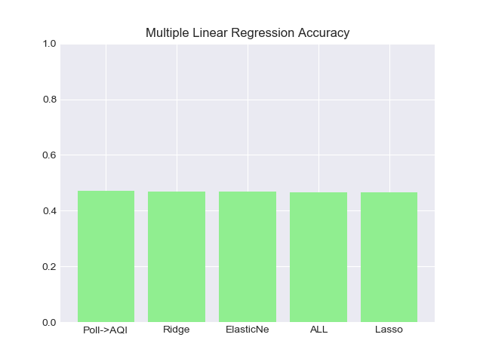
Predicting individual pollutants increased accuracy to 47% Predicting AQI
Model
47%
MLR to predict individual pollutants
Accuracy
MSE
39%
Naïve Model

Slide 42
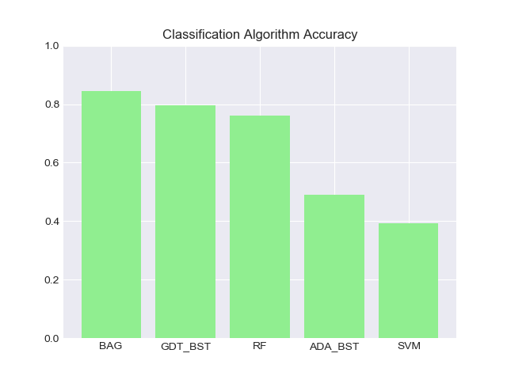
Ensemble classification algorithms were most accurate, with bagging at 84%, gradient boosting at 80% and random forest at 76% Predicting AQI
Model
84%
Bagging Classifier
47%
MLR to predict individual pollutants
Accuracy
MSE

Slide 43
III. Model
Train/Test Split
Predicting AQI
Feature Selection
Final Model

Slide 44
Several methods that have been used can inform our final choice of variables Feature Selection
Model
Embedded methods: Random Forest Feature Importance
RF was by far the better model so this will be weighted more heavily
Penalization methods: Lasso Coefficients
Picture: https://www.123rf.com/photo_20237672_turtle-on-money.html

Slide 45
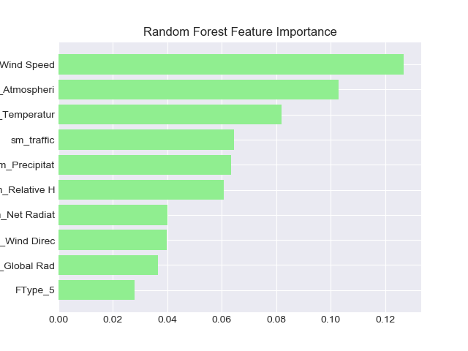
Random forest rates wind speed, atmospheric pressure, and temperature as the most important features Feature Selection
Model
Global Radiation was highly correlated with Net Radiation, had the highest MSE in solo linear regression, and universally rates below Net Radiation, so we will drop it
Picture: https://www.123rf.com/photo_20237672_turtle-on-money.html

Slide 46
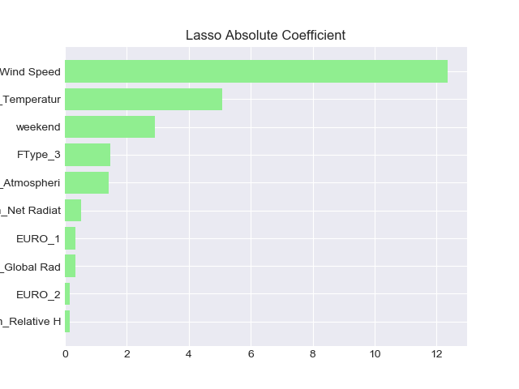
Lasso coefficients also indicate wind speed is most important Feature Selection
Model
Weekend is surprisingly high here even though it was ranked very low in feature importance. It is also the only temporal variable. It will be included in the final analysis
Picture: https://www.123rf.com/photo_20237672_turtle-on-money.html

Slide 47
III. Model
Train/Test Split
Predicting AQI
Feature Selection
Final Model

Slide 48
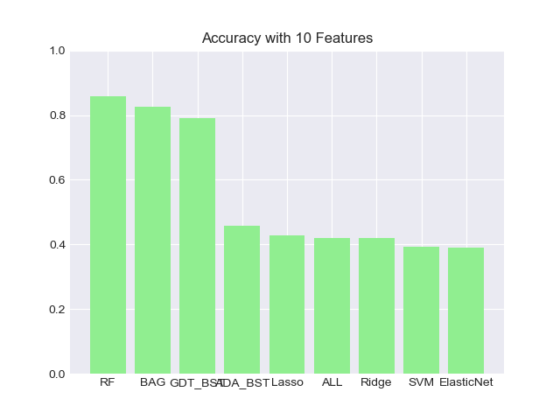
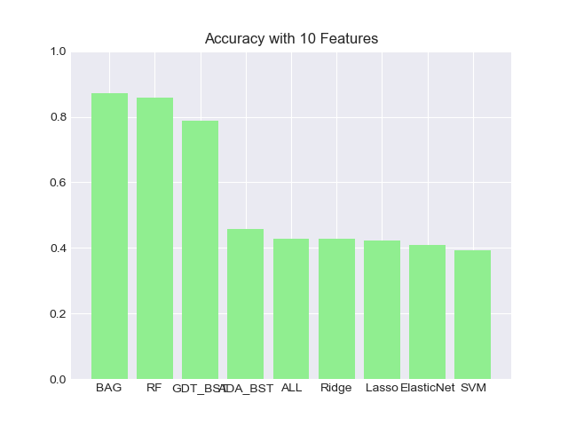
Using a set of 10 features only improves accuracy from 84% to 86%, but parsimony is enhanced Final Model
Model
86%
Random Forest Classifier
Accuracy
Picture: https://www.123rf.com/photo_20237672_turtle-on-money.html

Slide 49
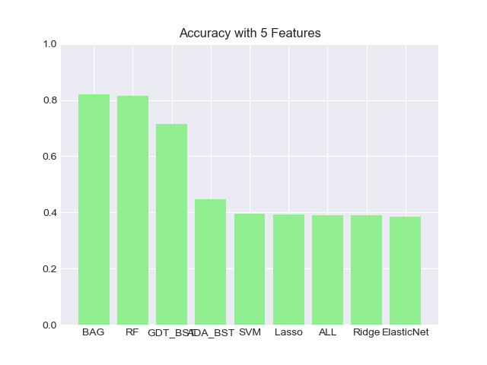
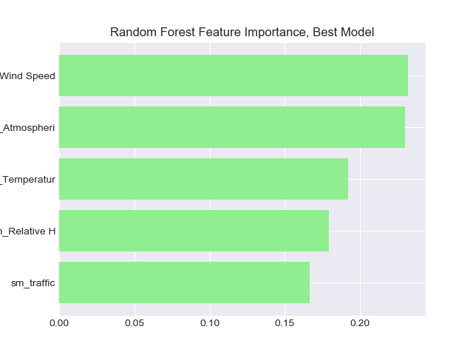
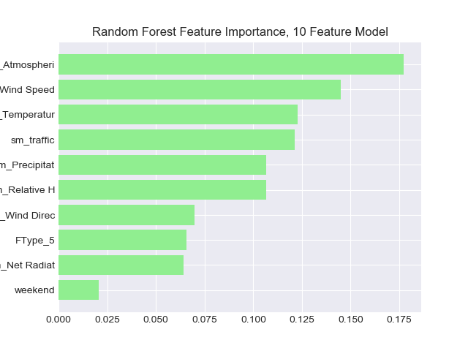
Weekend is still not considered important by the random forest model Final Model
Model
Picture: https://www.123rf.com/photo_20237672_turtle-on-money.html

Slide 50
The model can halve its features to 5 with only a small decrease in accuracy Final Model
Model
82%
Random Forest and Bagging Classifiers
Accuracy
Picture: https://www.123rf.com/photo_20237672_turtle-on-money.html

Slide 51
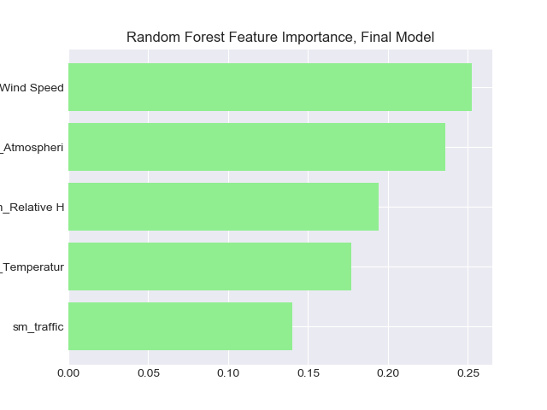
There is no great disparity in the importance of the remaining features Final Model
Model
Picture: https://www.123rf.com/photo_20237672_turtle-on-money.html

Slide 52
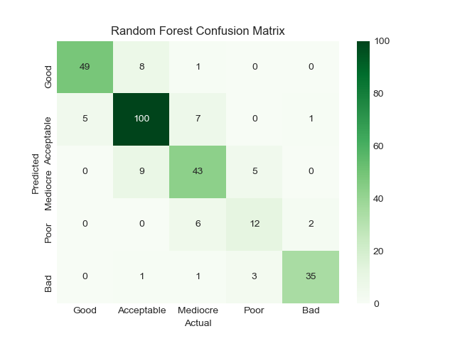
Random forest has 82% accuracy, misses by >2 classes 1.4%, and missed by 3 classes 0.7% Final Model
Model
Picture: https://www.123rf.com/photo_20237672_turtle-on-money.html

Slide 53
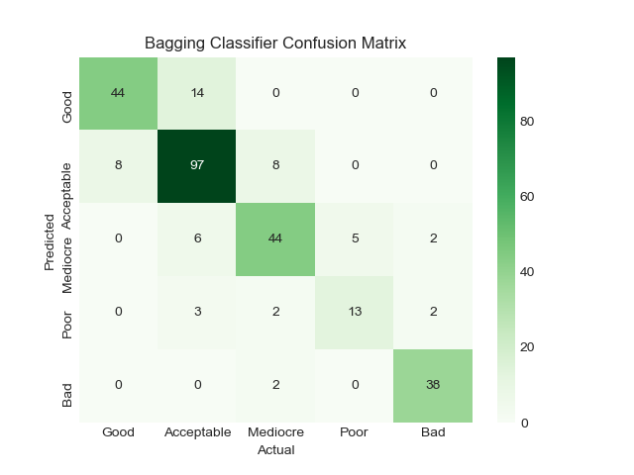
Bagging also has accuracy of 82%, misses by 2+ classes 2.4% of the time, but does not miss by 3 or more classes Final Model
Model
Picture: https://www.123rf.com/photo_20237672_turtle-on-money.html

Slide 54
IV. Conclusion

Slide 55
The Air Quality Index is ~ 80%predictable on an hourly basis using mostly weather variables Conclusion
Conclusion
Only one traffic variable was included in the final model, and it was about as important as each of the four weather variables present
Ensemble models are better at predicting air quality from weather and traffic
This does not rule out that variables like the number of hybrid vehicles and diesel particulate filters could be valuable to air quality long term
Picture: https://www.123rf.com/photo_20237672_turtle-on-money.html

Slide 56
V. Recommendation

Slide 57
Decision makers should use a bagging model based on a set of 5 variables to predict the AQI in Milan Recommendation
Recommendation
Bagging has accuracy of nearly double that of more interpretable models using linear regression, and the incidence of large errors is less than random forest
Large overestimates of air quality might be more beneficial to avoid. A recommendation to go outside when air quality is Bad could be more harmful to health, for example
Few variables reduces data requirements and makes clear what is important to the model in the absence of interpretable estimators
The five variables are
Atmospheric Pressure
Wind Speed
Temperature
Relative Humidity
Traffic
Picture: https://www.123rf.com/photo_20237672_turtle-on-money.html

Slide 58
Data collection should continue, and the model should be retrained regularly to overcome initial weaknesses in analysis Recommendation
Recommendation
A sequential train/test set was not practical due to small amounts of data, this approach will need to be retested to see if it is robust going forward
The model will also need to be revisited with data for other seasons, since it has only considered November and December
Picture: https://www.123rf.com/photo_20237672_turtle-on-money.html

